Slide 1
Infinite Geometric Series
To Infinity … and Beyond!

Slide 2
Agenda
Today, you will …
Learn a formula for quickly summing infinite geometric series
Practice using English to describe math processes and equations

Slide 3
Review: Formula for Geometric Series
The sum of the first $n$ terms of a geometric series is …
$$\sum_{i=1}^{n}{a_{1}(r^{i−1})}=a_{1}\frac{1−r^{n}}{1−r}$$

Slide 4
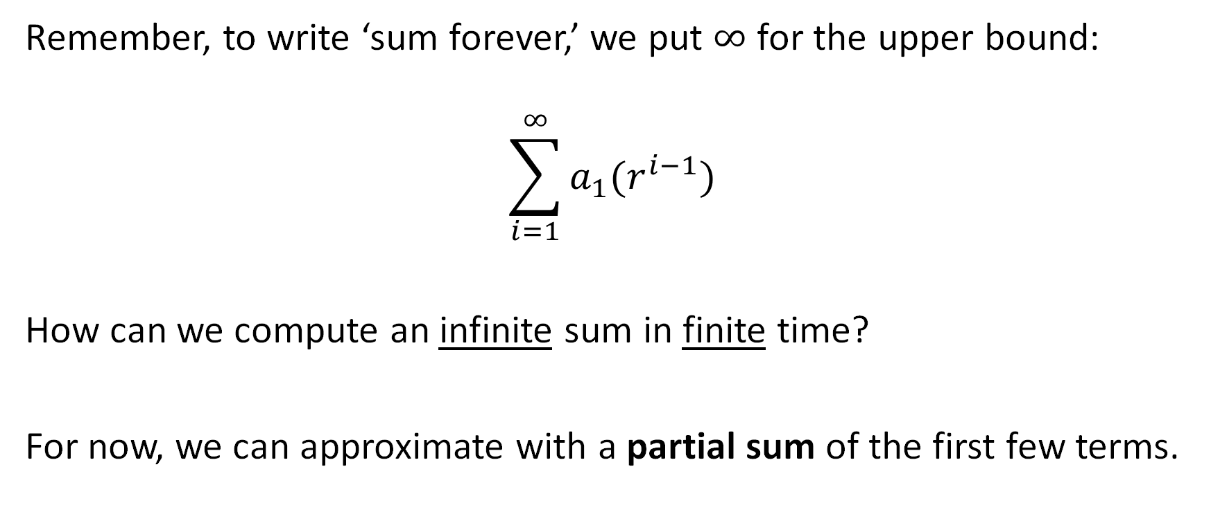
What if we kept summing forever?
Remember, to write ‘sum forever,’ we put $∞$ for the upper bound:
$$\sum_{i=1}^{∞}{a_{1}(r^{i−1})}$$
How can we compute an infinite sum in finite time?
For now, we can approximate with a partial sum of the first few terms.
¯\(ツ)/¯

Slide 5


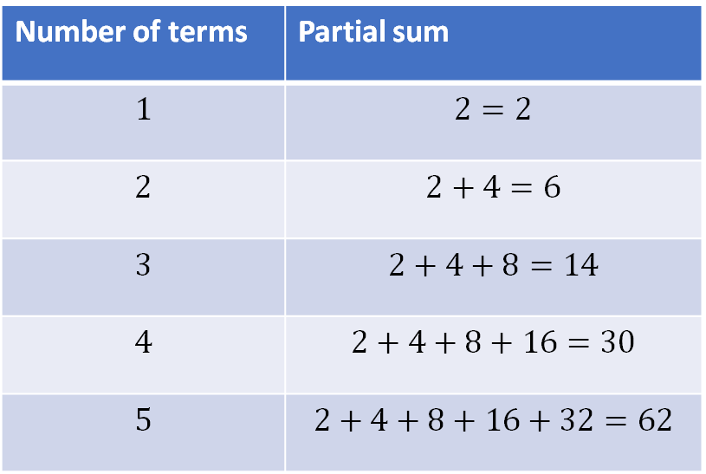
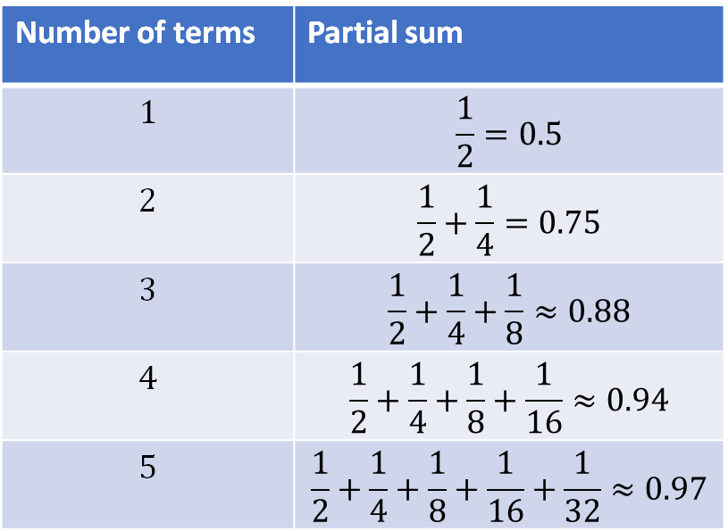
Partial Sums
This one seems to grow forever
Does this infinite series ever grow past 1?
$$\sum_{i=1}^{∞}{2^{i}}$$
$$\sum_{i=1}^{∞}{{\left(\frac{1}{2}\right)}^{i}}$$
Number of terms | Partial sum
$$1$$ | $$2=2$$
$$2$$ | $$2+4=6$$
$$3$$ | $$2+4+8=14$$
$$4$$ | $$2+4+8+16=30$$
$$5$$ | $$2+4+8+16+32=62$$
Number of terms | Partial sum
$$1$$ | $$\frac{1}{2}=0.5$$
$$2$$ | $$\frac{1}{2}+\frac{1}{4}=0.75$$
$$3$$ | $$\frac{1}{2}+\frac{1}{4}+\frac{1}{8}≈0.88$$
$$4$$ | $$\frac{1}{2}+\frac{1}{4}+\frac{1}{8}+\frac{1}{16}≈0.94$$
$$5$$ | $$\frac{1}{2}+\frac{1}{4}+\frac{1}{8}+\frac{1}{16}+\frac{1}{32}≈0.97$$

Slide 6
Convergent Series
When an infinite series has a finite sum, we say it converges to that sum.
“The series $\frac{1}{2}+\frac{1}{4}+\frac{1}{8}+…$ converges to 1.”
A series which converges is called a convergent series.
If a series does not converge, we say it diverges. (Its sum does not exist.)
Series that diverge are called divergent series.

Slide 7
Converging and Diverging
$$\sum_{i=1}^{∞}{2^{i}}$$
$$\sum_{i=1}^{∞}{{\left(\frac{1}{2}\right)}^{i}}$$
This geometric series seems to diverge
This geometric series seems to converge to 1
Number of terms | Partial sum
$$1$$ | $$2=2$$
$$2$$ | $$2+4=6$$
$$3$$ | $$2+4+8=14$$
$$4$$ | $$2+4+8+16=30$$
$$5$$ | $$2+4+8+16+32=62$$
Number of terms | Partial sum
$$1$$ | $$\frac{1}{2}=0.5$$
$$2$$ | $$\frac{1}{2}+\frac{1}{4}=0.75$$
$$3$$ | $$\frac{1}{2}+\frac{1}{4}+\frac{1}{8}≈0.88$$
$$4$$ | $$\frac{1}{2}+\frac{1}{4}+\frac{1}{8}+\frac{1}{16}≈0.94$$
$$5$$ | $$\frac{1}{2}+\frac{1}{4}+\frac{1}{8}+\frac{1}{16}+\frac{1}{32}≈0.97$$

Slide 8
How come some infinite geometric series converge, but others diverge?
How can I predict whether a geometric series will converge or diverge?

Slide 9
Let’s investigate!
We already know a formula for finite geometric series:
$$\sum_{i=1}^{n}{a_{1}(r^{i−1})}=a_{1}\frac{1−r^{n}}{1−r}$$
Let’s keep $n$ finite, and study what happens as it keeps getting bigger.
Hopefully, we can extrapolate to what would happen if $n$ was infinite.

Slide 10

Analysis
Let’s say $r>1$
Then, when $n$ is a big number,
$r^{n}$ is a very big number!
As $n$ grows, the only term that changes is $r^{n}$
$$\sum_{i=1}^{n}{a_{1}(r^{i−1})}=a_{1}\frac{1−r^{n}}{1−r}$$
Example: $r=2$, $n=40$ $2^{40}=1099511627776$ !
Then the whole sum ends up being huge too!
$$\frac{1−2^{n}}{1−2}=\frac{−1099511627775}{−1}=1099511627775$$
There’s no limit on how big the sum can get
So we say the series diverges. It has no sum.
What happens to $r^{n}$ as $n$ grows?
… it depends on $r$!

Slide 11
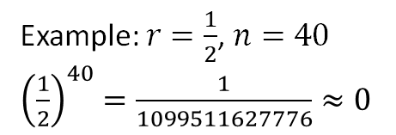
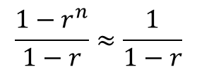
Analysis
Now instead, let’s say $r<1$
Then, when $n$ is a big number,
$r^{n}$ is a tiny number!
As $n$ grows, the only term that changes is $r^{n}$
$$\sum_{i=1}^{n}{a_{1}(r^{i−1})}=a_{1}\frac{1−r^{n}}{1−r}$$
Example: $r=\frac{1}{2}$, $n=40$ ${\left(\frac{1}{2}\right)}^{40}=\frac{1}{1099511627776}≈0$
The $r^{n}$ term ‘disappears’ from the sum
$$\frac{1−r^{n}}{1−r}≈\frac{1}{1−r}$$
There’s no limit how small $r^{n}$ can get
So, there’s no limit how close $\frac{1−r^{n}}{1−r}$ can get to $\frac{1}{1−r}$
What happens to $r^{n}$ as $n$ grows?
Thus, we say this series converges to $\frac{1}{1−r}$
… it depends on $r$!

Slide 12
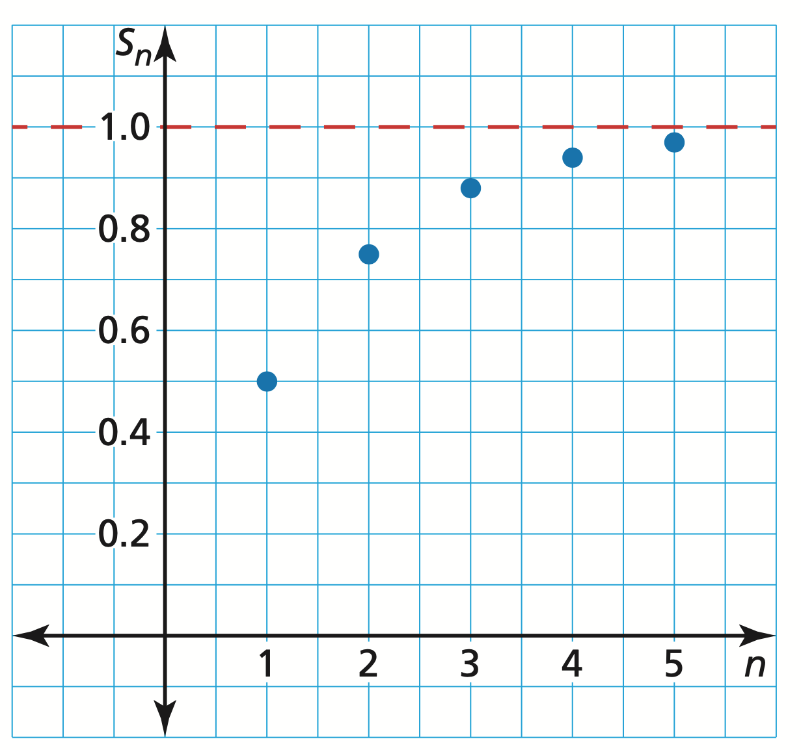
“Converging” and Asymptotes
For $r<1$, the function …
$$f\left(n\right)=\sum_{i=1}^{n}{a_{1}(r^{i−1})}$$
… has a horizontal asymptote at
$$y=\frac{a_{1}}{1−r}$$

Slide 13

Formula for Infinite Geometric Series
$$\sum_{i=1}^{n}{a_{1}(r^{i−1})}$$
An infinite geometric series …
Converges to $\frac{a_{1}}{1−r}$ when $\left|r\right|<1$
Diverges when $\left|r\right|≥1$

Slide 14
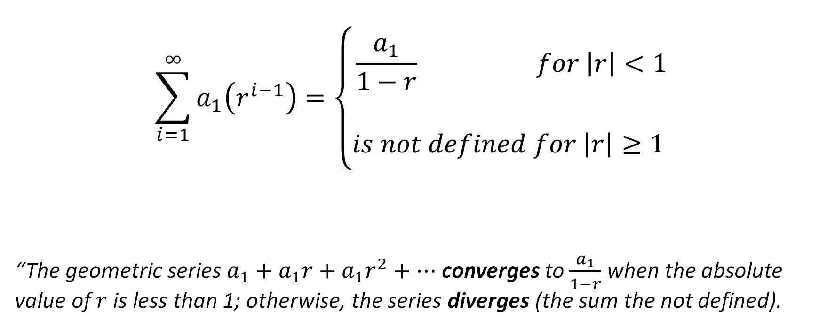
Formula for Infinite Geometric Series
$$\sum_{i=1}^{∞}{a_{1}\left(r^{i−1}\right)=\left\{\begin{aligned}\frac{a_{1}}{1−r} for \left|r\right|<1 \\ \\ is not defined for \left|r\right|≥1 \end{aligned}\right.}$$
“The geometric series $a_{1}+a_{1}r+a_{1}r^{2}+…$ converges to $\frac{a_{1}}{1−r}$ when the absolute value of $r$ is less than 1; otherwise, the series diverges (the sum the not defined).

Slide 15
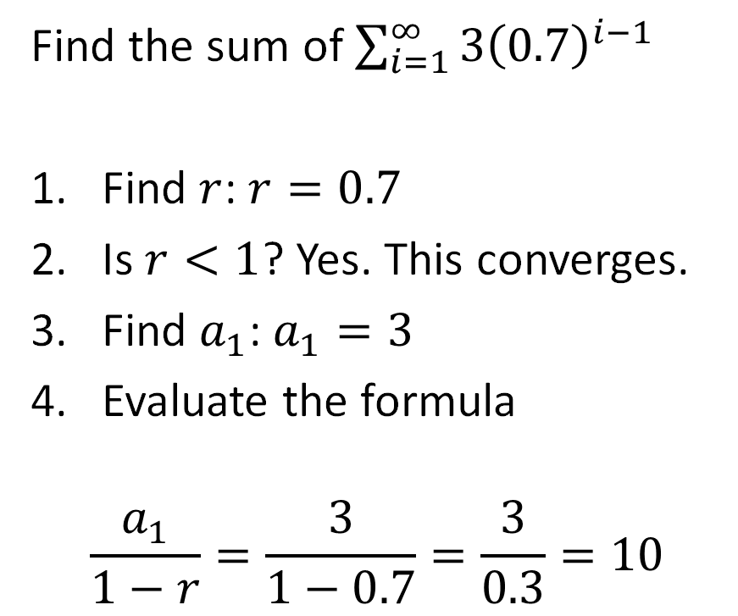
Practice: Finding Sums
$$\sum_{i=1}^{∞}{a_{1}\left(r^{i−1}\right)=\left\{\begin{aligned}\frac{a_{1}}{1−r} for \left|r\right|<1 \\ \\ is not defined for \left|r\right|≥1 \end{aligned}\right.}$$
Find the sum of $\sum_{i=1}^{∞}{3{\left(0.7\right)}^{i−1}}$
Find $r$: $r=0.7$
Is $r<1$? Yes. This converges.
Find $a_{1}$: $a_{1}=3$
Evaluate the formula
$$\frac{a_{1}}{1−r}=\frac{3}{1−0.7}=\frac{3}{0.3}=10$$
Find the sum of $1+3+9+…$
Write a rule: $\sum_{i=1}^{∞}{1(3^{i−1})}$
Find $r$: $r=3$
Is $r<1$? No. This diverges.
“The sum does not exist. The series diverges because $r≥1$.”

Slide 16
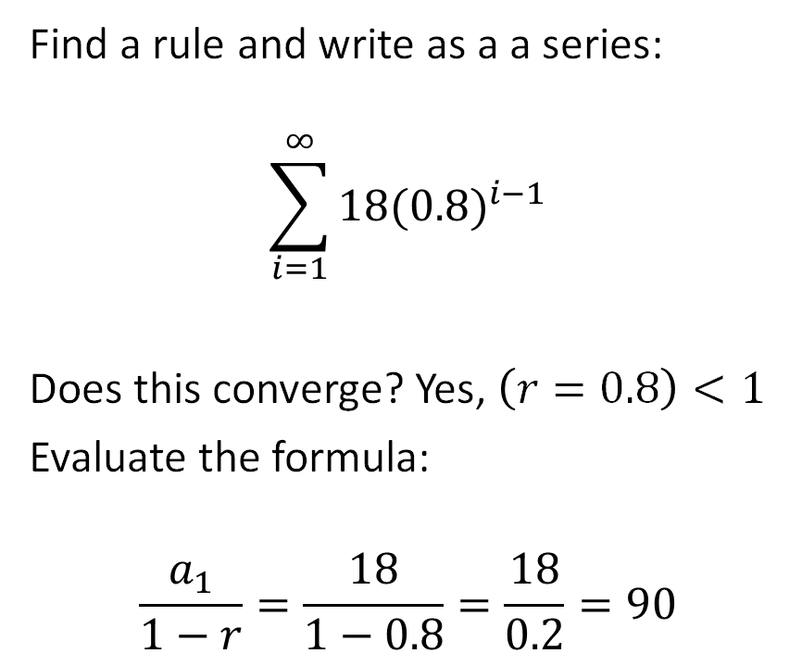
A pendulum that is released to swing freely travels 18 inches on the fi rst swing. On each successive swing, the pendulum travels 80% of the distance of the previous swing.
What is the total distance the pendulum swings?
Find a rule and write as a a series:
$$\sum_{i=1}^{∞}{18({0.8)}^{i−1}}$$
Does this converge? Yes, $\left(r=0.8\right)<1$
Evaluate the formula:
$$\frac{a_{1}}{1−r}=\frac{18}{1−0.8}=\frac{18}{0.2}=90$$
inches

Slide 17
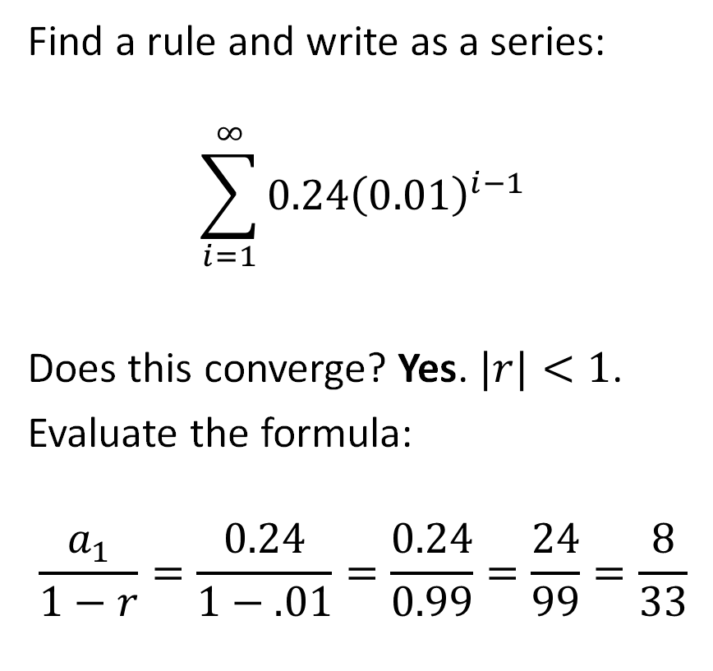
Practice: Repeating Fractions
Write $0.242424…$ as a fraction in simplest form.
Note: $0.24242424…=$
$$0.24+0.0024+0.000024+…$$
Find a rule and write as a series:
$$\sum_{i=1}^{∞}{0.24{\left(0.01\right)}^{i−1}}$$
Does this converge? Yes. $|r|<1$.
Evaluate the formula:
$$\frac{a_{1}}{1−r}=\frac{0.24}{1−.01}=\frac{0.24}{0.99}=\frac{24}{99}=\frac{8}{33}$$

Slide 18
Homework
p439 #7-10 all, 18-22 even

